Slide 1

DEPARTMENT OF SOFTWARE ENGINEERING Zohaib Ali (139) Hitesh Kumar (122) Abdur Rauf (255)

Slide 2
E-Commerce Platform

Slide 3
Introduction
E-commerce platform, this project involves the design and implementation of a relational database using MySQL to manage the core features of the e-commerce platform. We created 10 interconnected tables: Customers, Categories, Products, Orders, Order Details, Suppliers, Product Suppliers, Reviews, Wish Lists, and Addresses. Through 45 SQL queries, we perform a wide range of operations like retrieving and updating of specific data from tables. We also created ER model of this project.

Slide 4
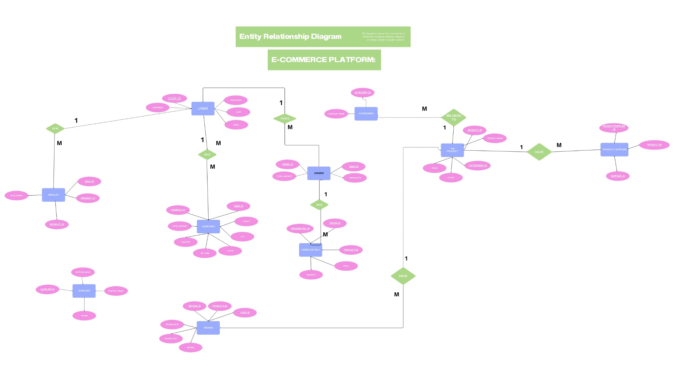
ER MODEL

Slide 5
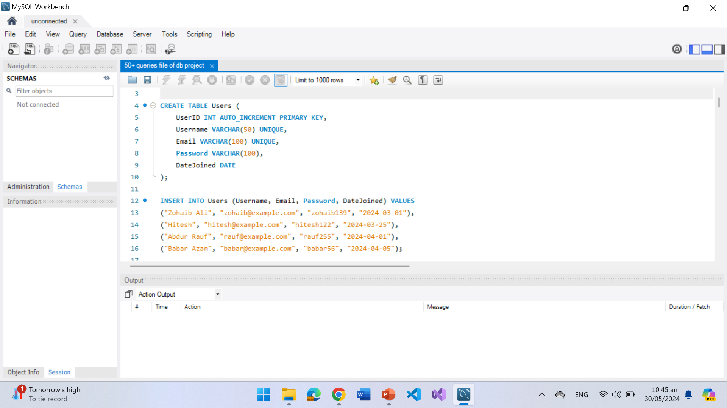
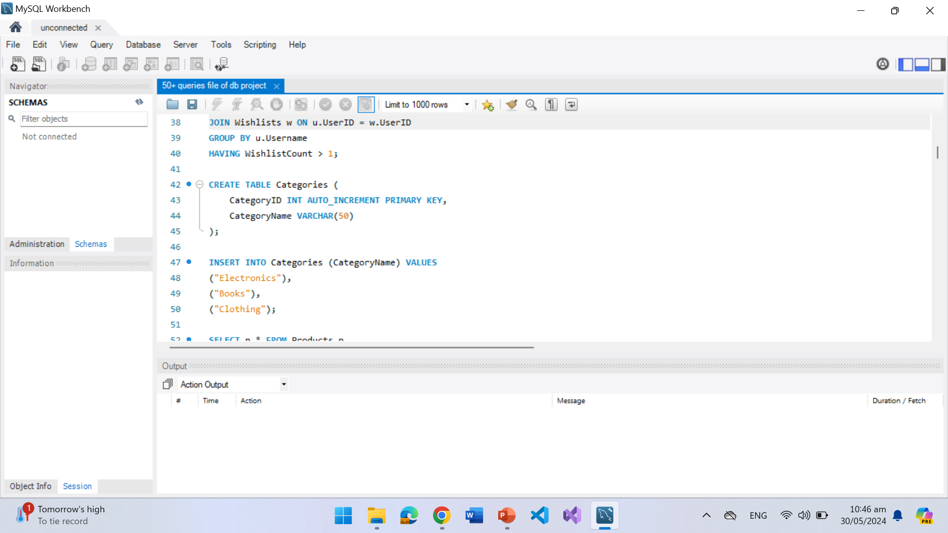
Code of 10 Tables

Slide 6
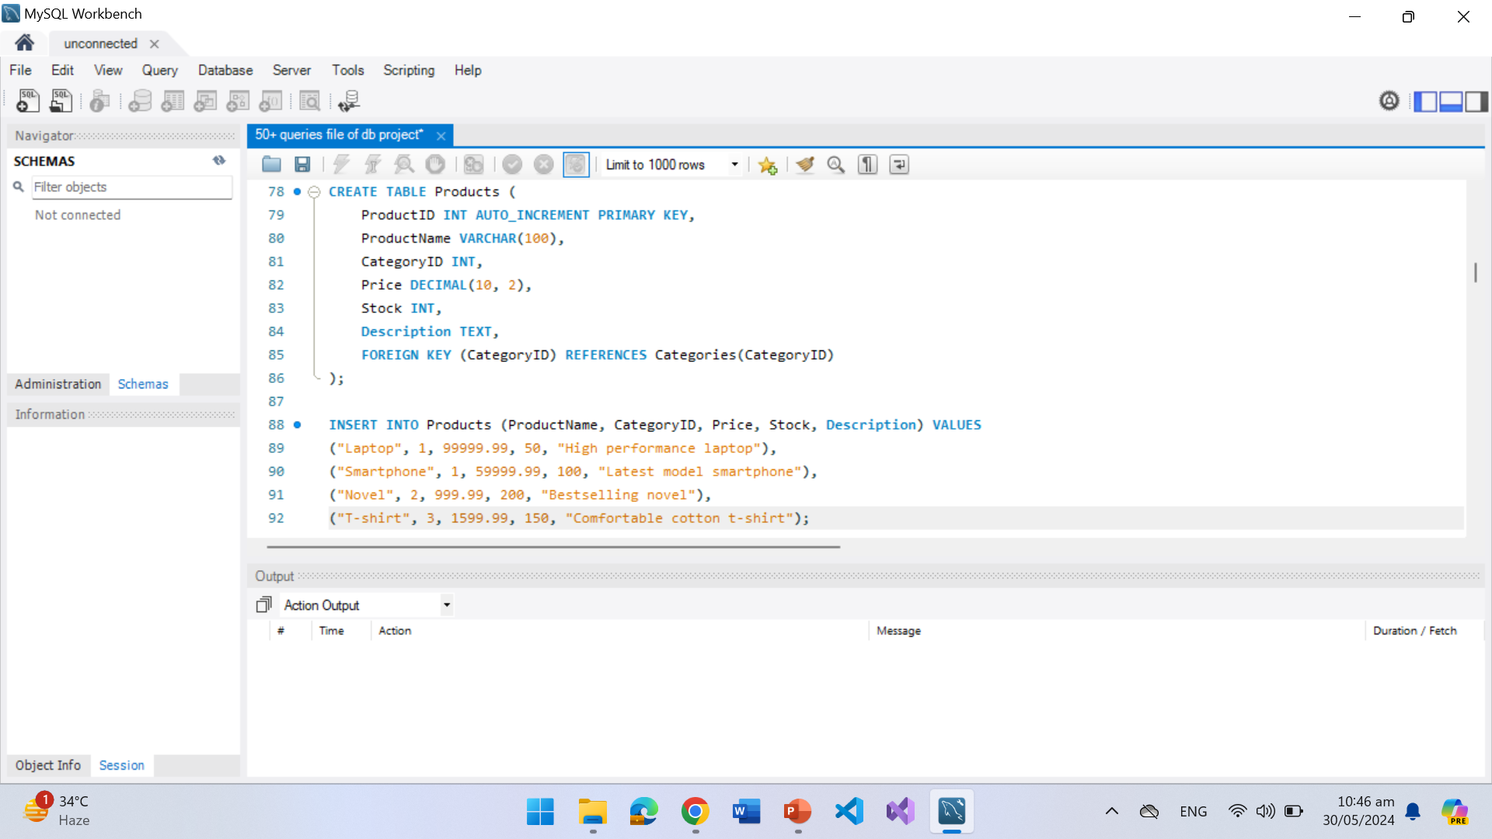
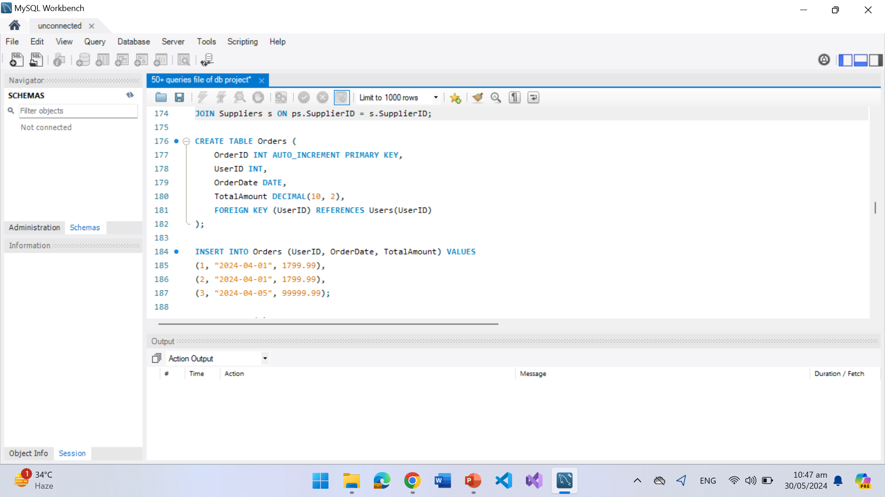

Slide 7
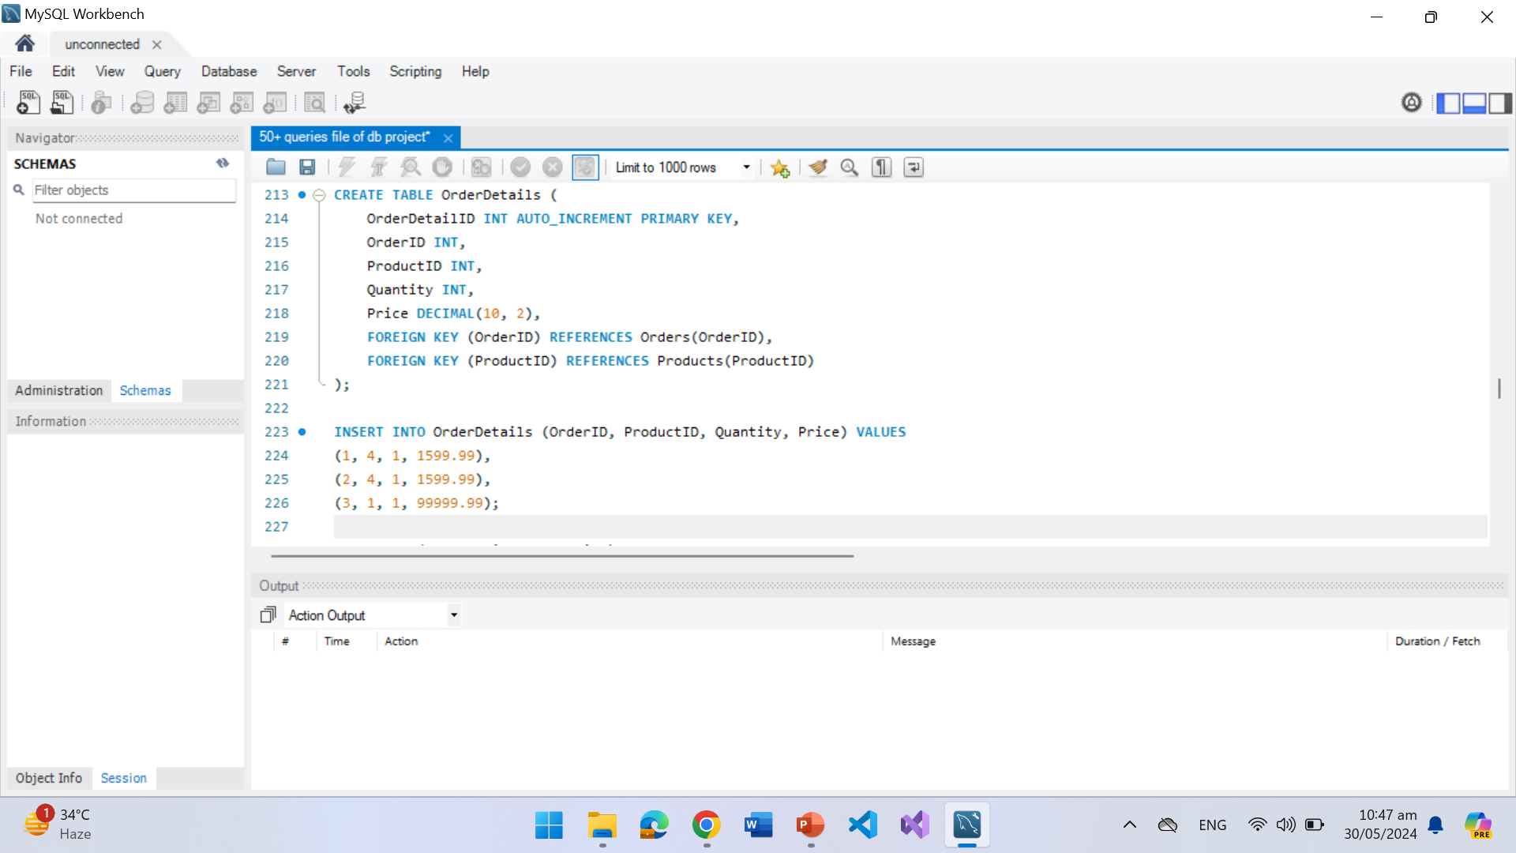
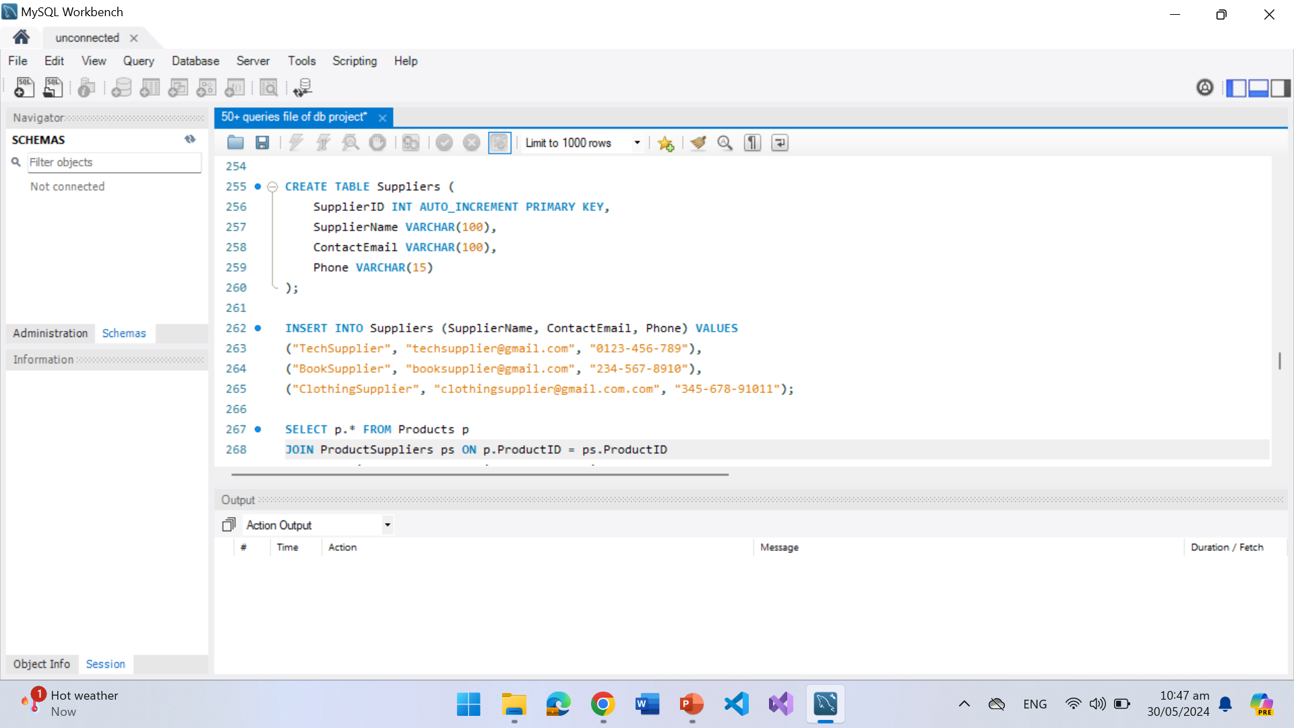

Slide 8
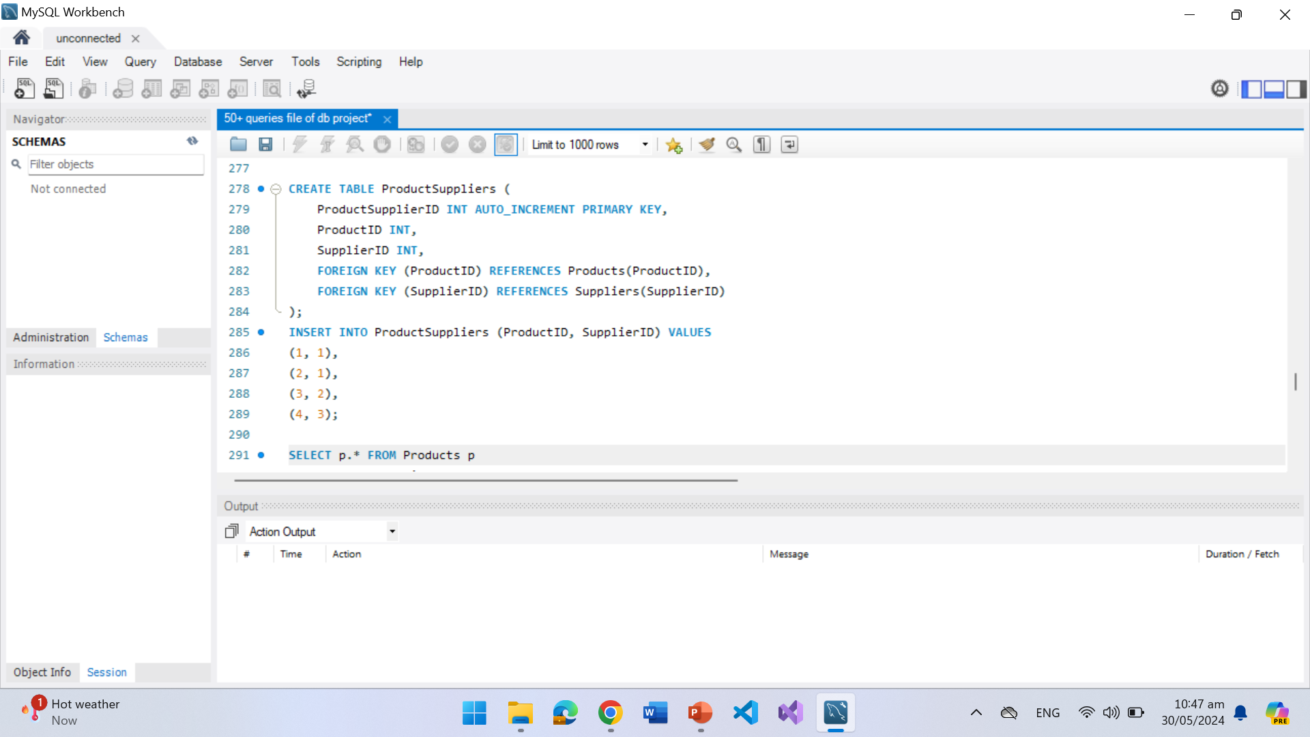
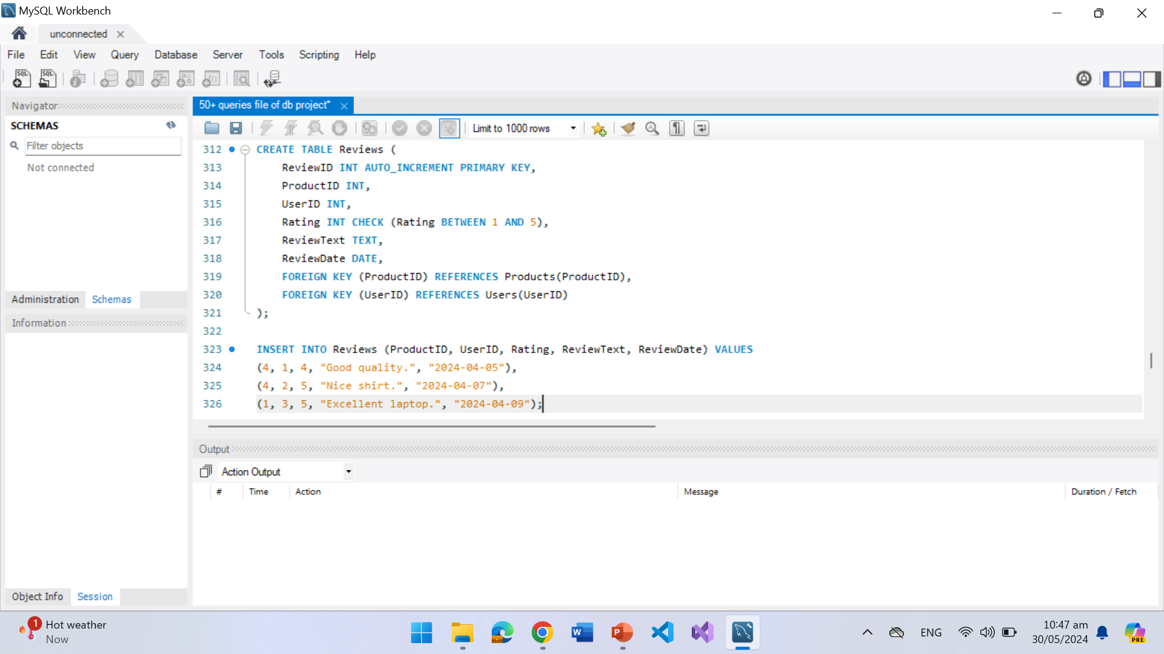

Slide 9
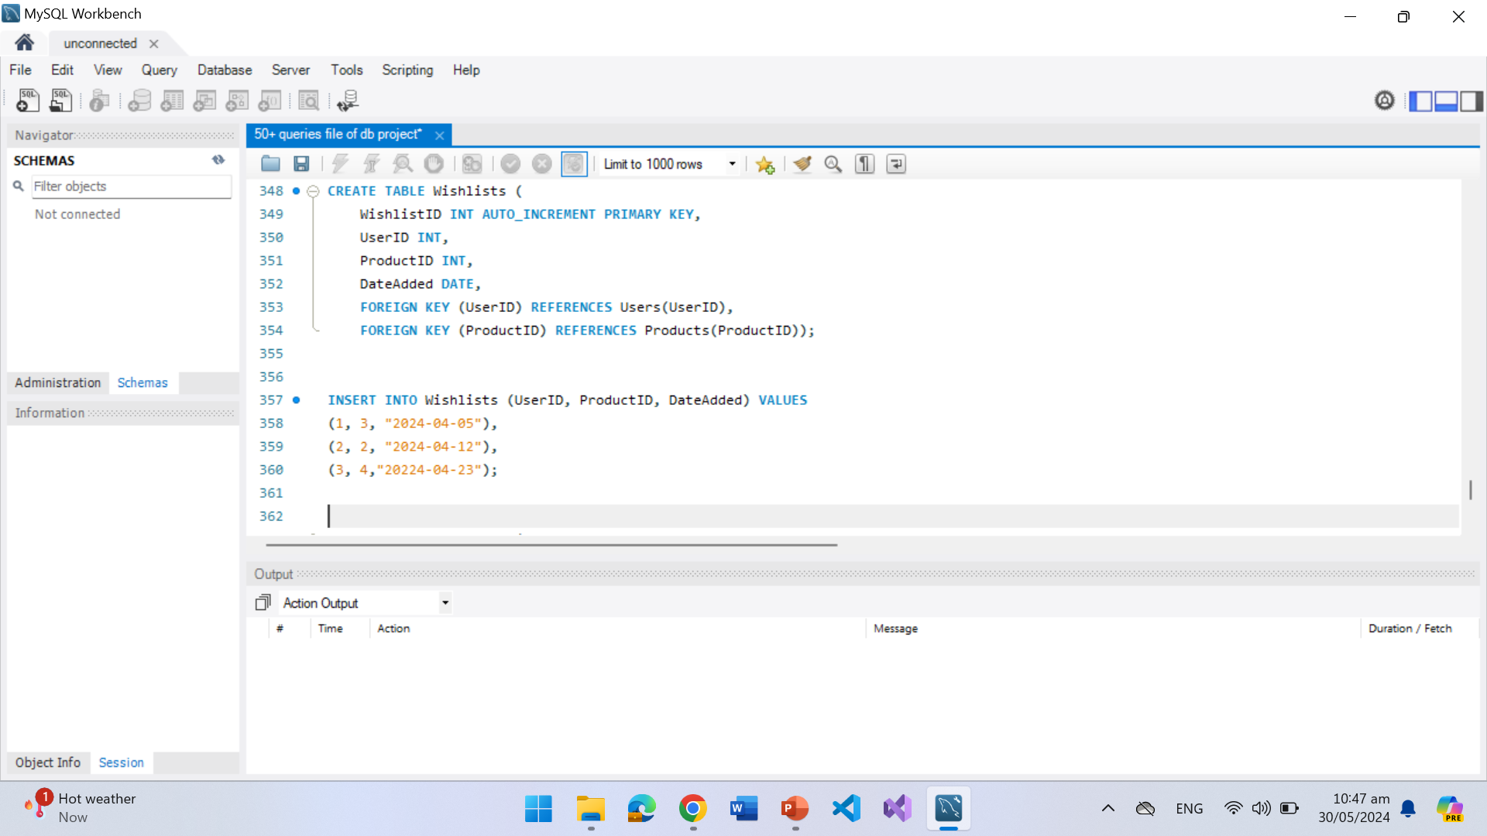
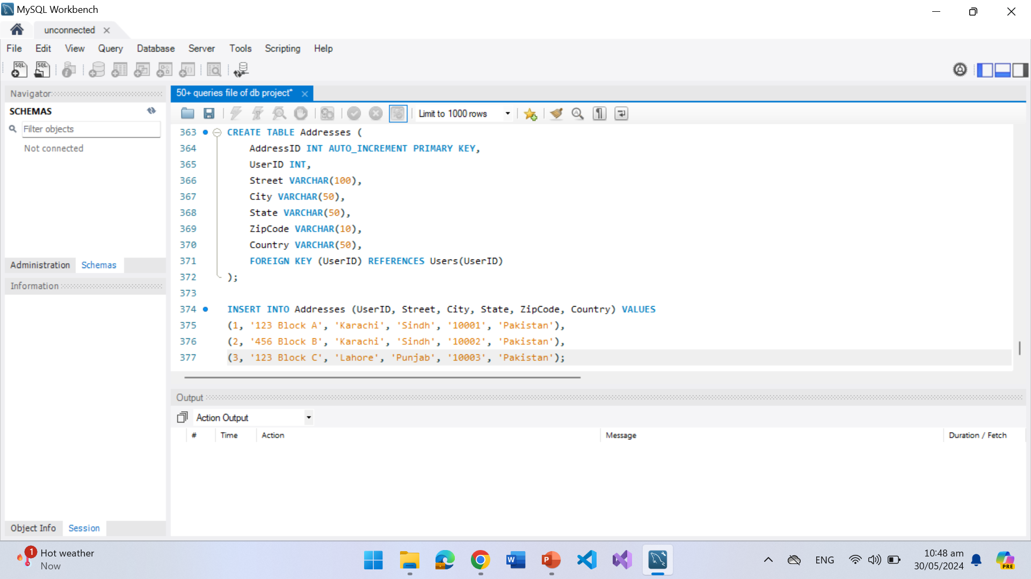

Slide 10
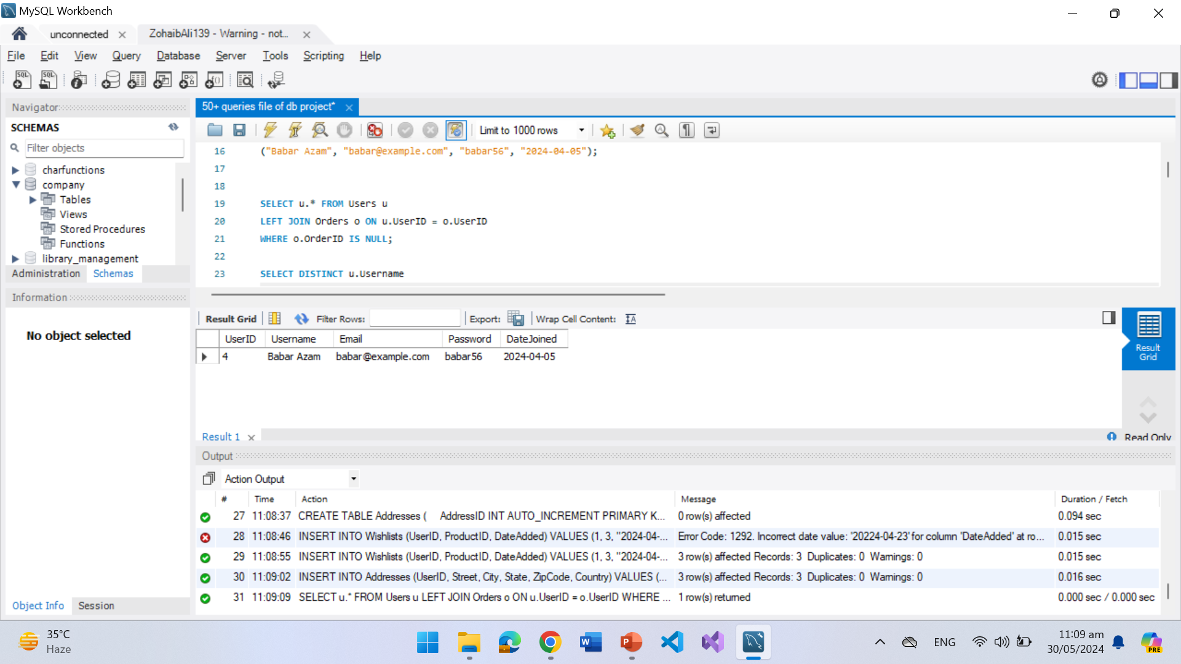
QUERIES AND OUTPUTS

Slide 11
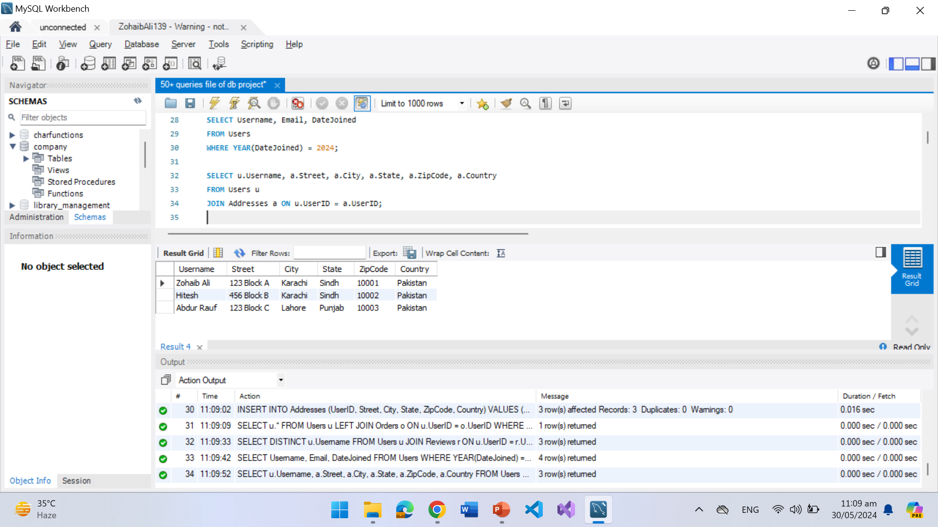

Slide 12
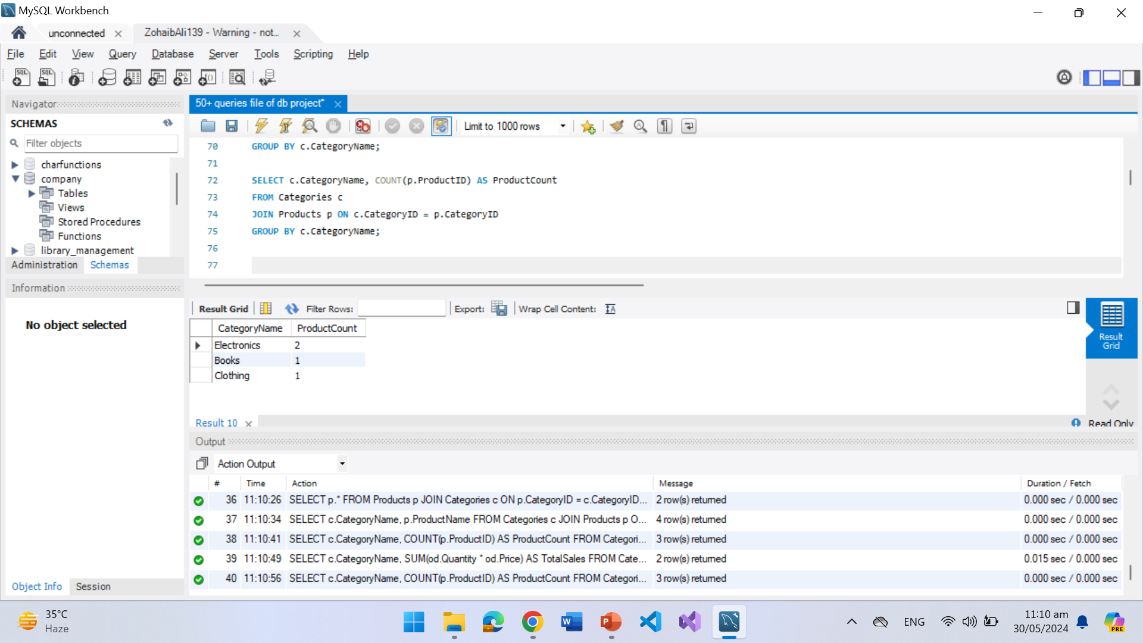

Slide 13
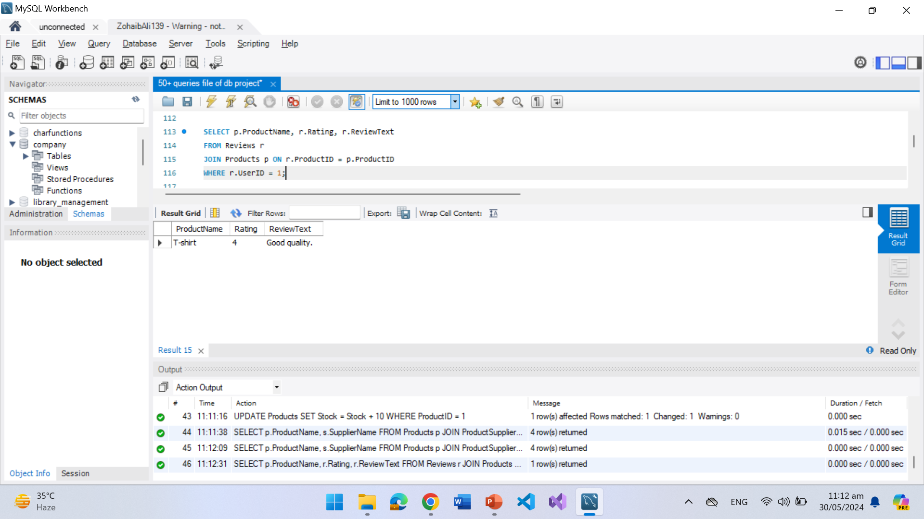

Slide 14
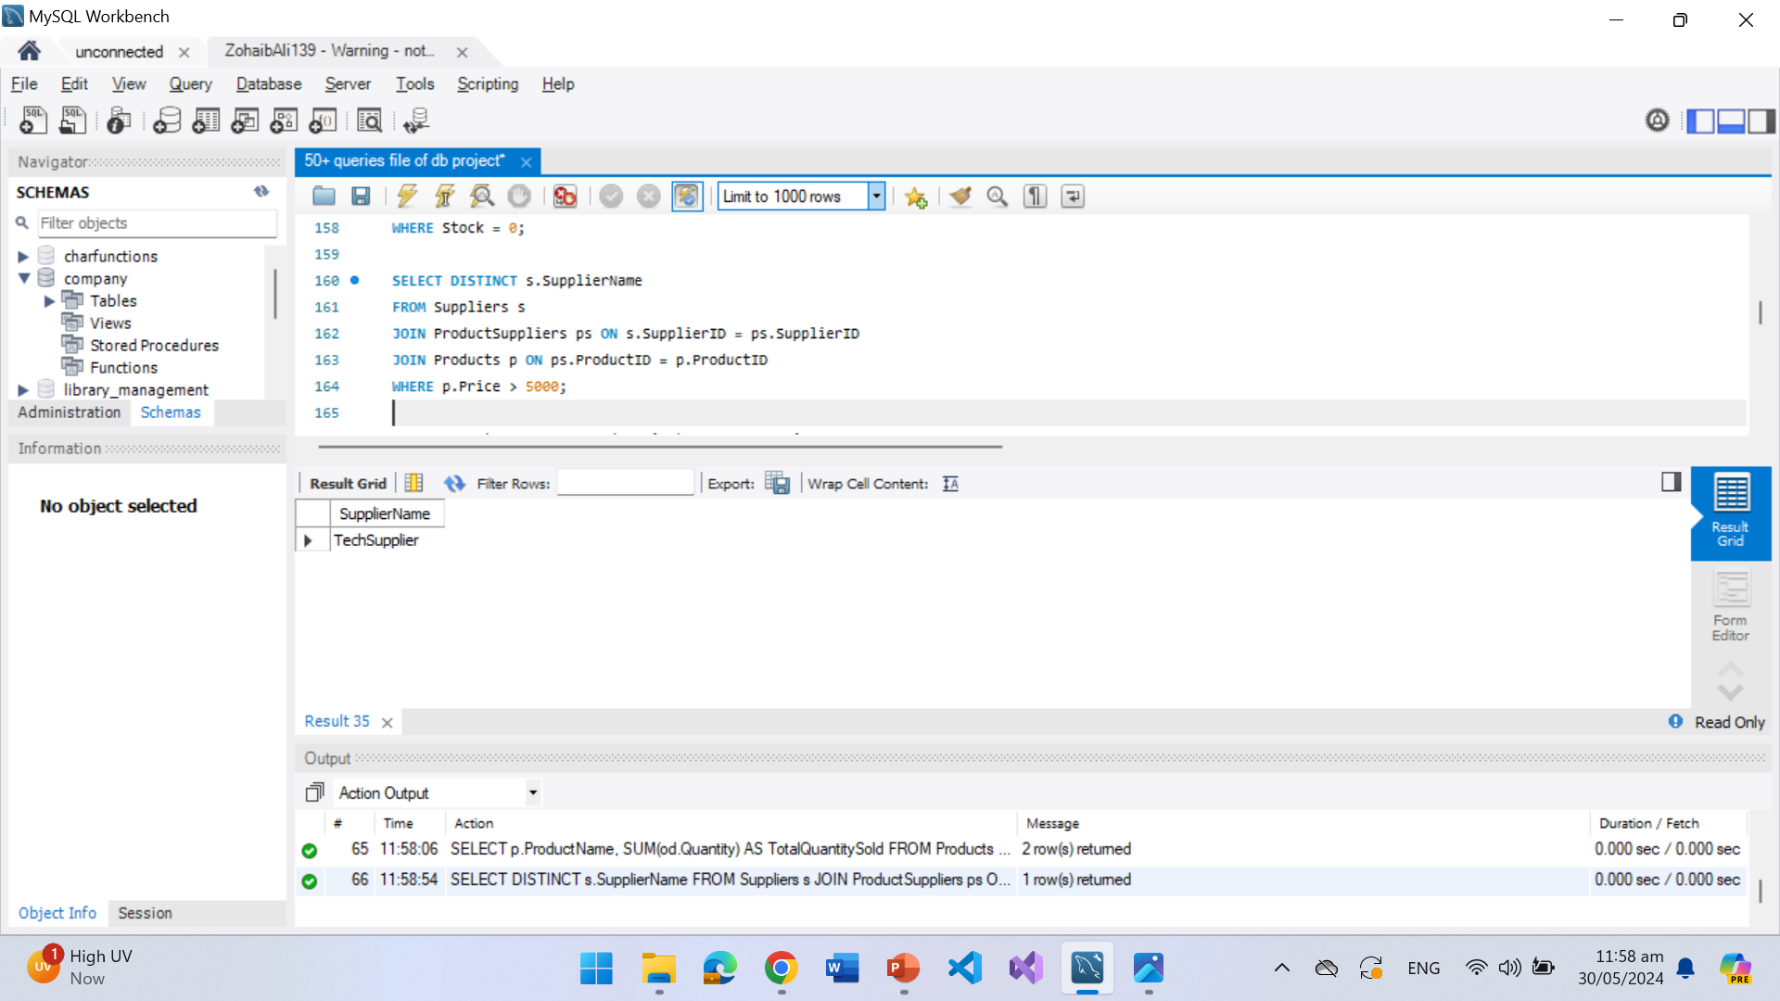
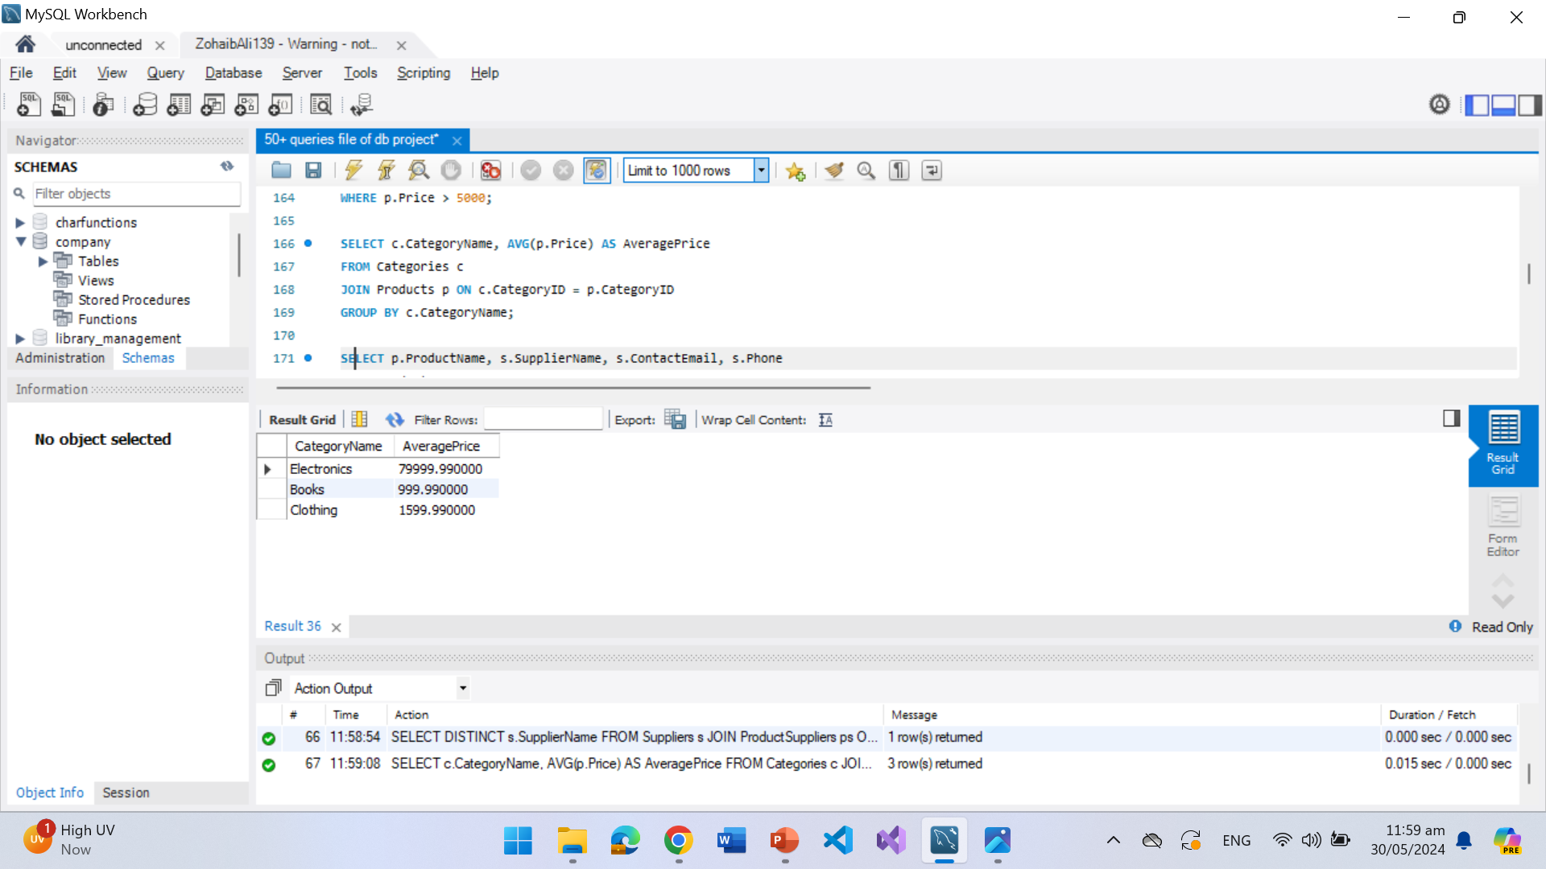

Slide 15
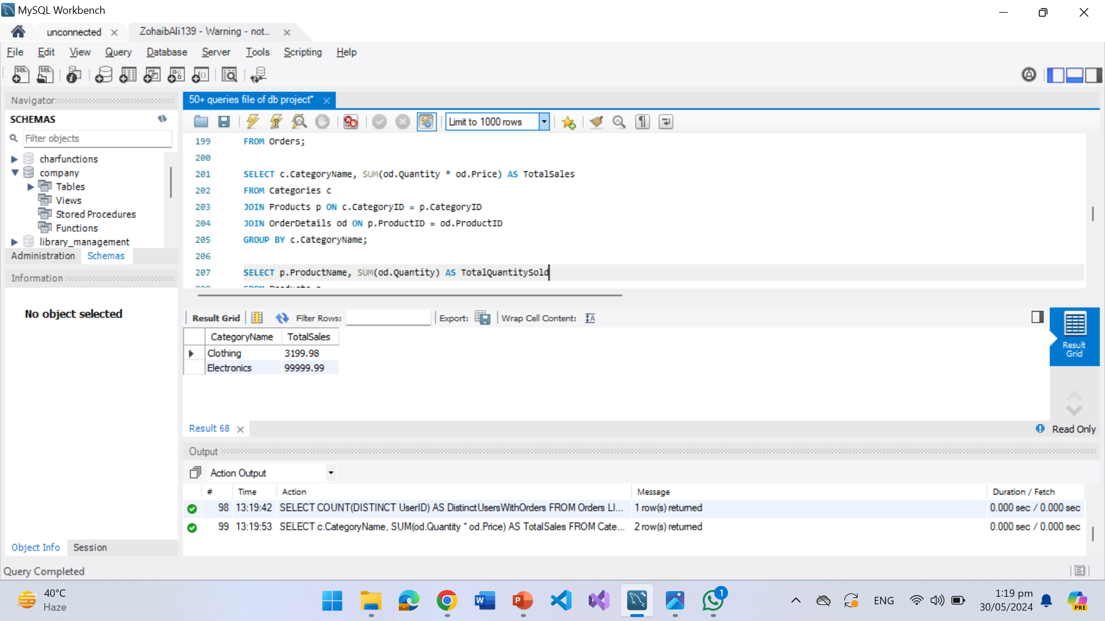

Slide 16
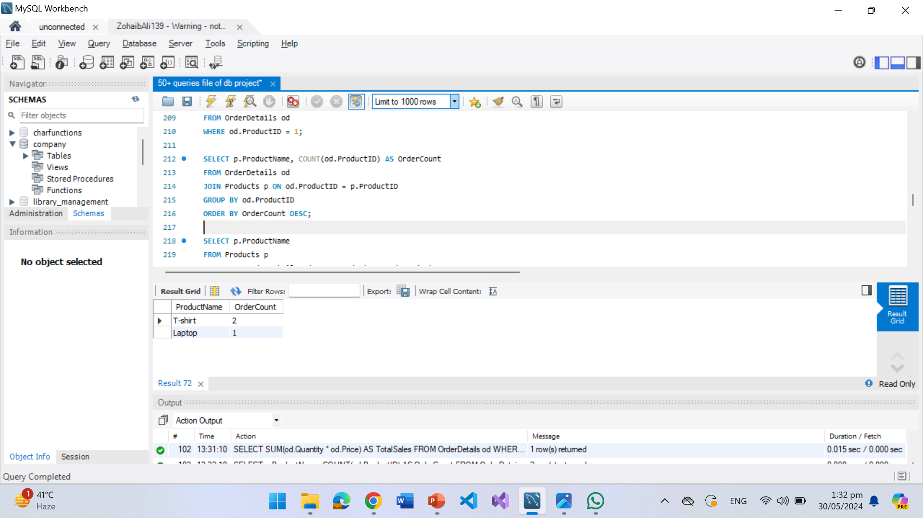

Slide 17
CONTRIBUTION
ZOHAIB ALI (139)
15 QUERIES
PPT
Github
ABDUR RAUF (255)
SCHEMAS
DATA INSERTION
15 Queries
HITESH KUMAR (122)
15 Queries
ER Model

Slide 18
THANKYOU FOR YOUR TIME ☺

